Slide 1
CSE326
Toll Management System
Topic: Class Diagram & ER Diagram
Presented by: Sourov(1705072) and Shafayat(1705080)
Group : 2
1705072 - Sourov
1705079 - Shammo
1705080 - Shafayat
1705081 - Kamrul
1705082 - Mehedi
1705084 - Utsa

Slide 2
Introduction
Project Idea: Toll Management System
Architecture used: Model View Controller (MVC)
Diagram Convention: Unified Modelling Language (UML)
Diagrams Generated:
Class Diagram
Entity Relationship (ER) Diagram
Model
View
Controller
Conceptual Diagramming
Used Throughout

Slide 3
Module Hierarchy
>Profile management
>Financial management
>Route management
>User History
4
User
Toll Management System
Admin
>Profile management
>Offer management
>Toll Booth management
>Gateway management
>History
5
TollBooth
1
>Finance management
3 Modules
10 Submodules

Slide 4
User Module
1.1 Profile Management

Slide 5
User: Profile Management
Description
User profile management sub module has the following tasks:
Log in
Sign Up
Profile Info View
Profile Info Edit
Homepage navigation
Model | View | Controller
User Vehicle | UserLoginUI UserSignupUI UserHomepageUI ProfileUI | UserController

Slide 6
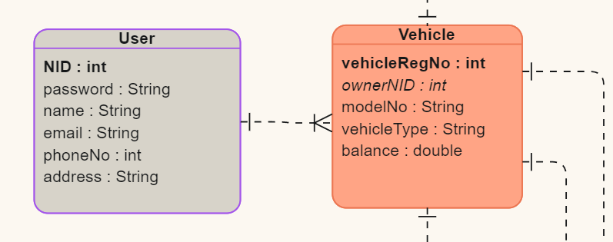
User: Profile Management
High Level View
UserHomepageUI
UserSignupUI
UserLoginUI
ProfileUI
UserController
1
1
User
1
1..*
Vehicle
Class Diagram: high level
ER Diagram

Slide 7
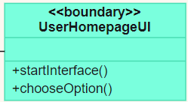
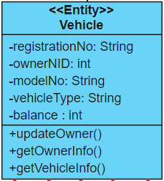
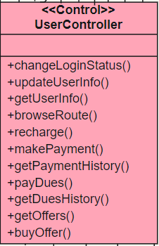
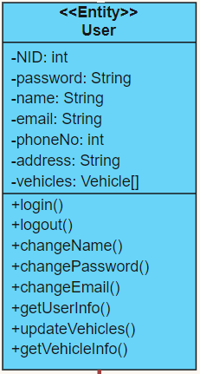
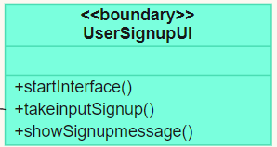
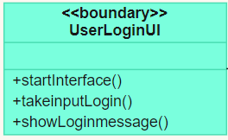
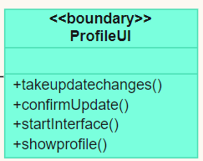
User: Profile Management
Implementation View
1
1
1..*
1
Class Diagram: Detailed

Slide 8
User Module
1.2 Financial Management

Slide 9
User: Financial Management
Description
User financial management sub module has the following tasks:
Recharge User wallet
Pay for selected toll booths
Recharging using various gateways
View list of dues
Pay pending dues
Model | View | Controller
Recharge Due Payment Offer Vehicle PaymentGateway | PaymentUI DuesUI OffersUI | UserController

Slide 10
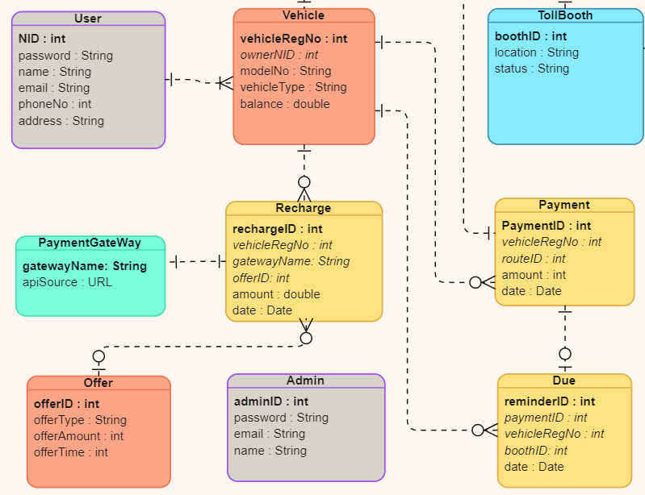
User: Financial Management
High Level View
PaymentUI
DuesUI
UserController
1
1
1
*
1
*
Due
*
Recharge
*
0..1
*
1
0..1
*
1
*
Vehicle
Offer
Payment
Class Diagram: high level
ER Diagram

Slide 11
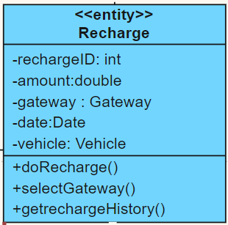
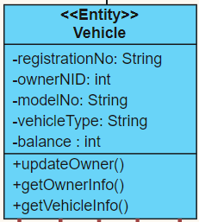
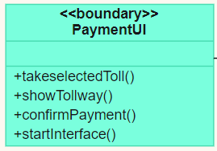
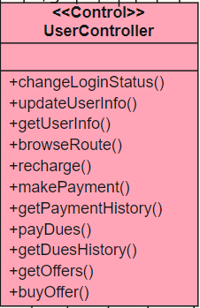
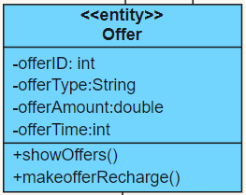
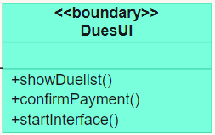
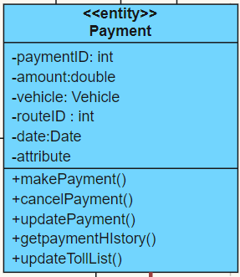
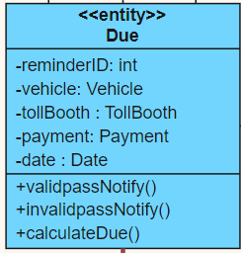
User: Financial Management
Implementation View
1
*
*
1
*
1
0..1
1
*
*
1
*
1
0..1
Class Diagram: Detailed

Slide 12
User Module
1.3 Route Management

Slide 13
User: Route Management
Description
User route management sub module has the following tasks:
Browse routes in map
See available toll booths
Selectively or generally select tollbooths for payment
Model | View | Controller
Route TollBooth Payment Vehicle | BrowseRouteUI | UserController

Slide 14
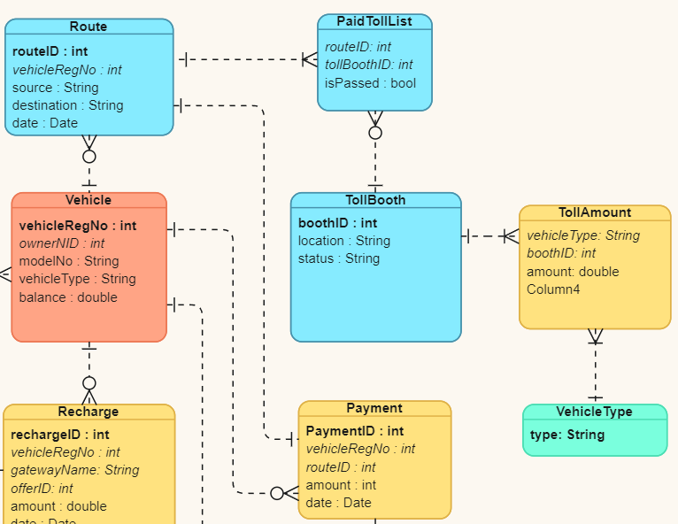
User: Route Management
High Level View
BrowseRouteUI
UserController
1
1
*
*
Route
1
1
Payment
1
1
*
1
TollBooth
Vehicle
Class Diagram: high level
ER Diagram

Slide 15
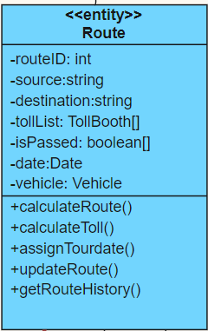
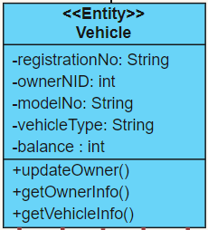
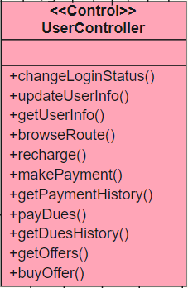
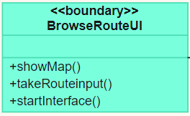
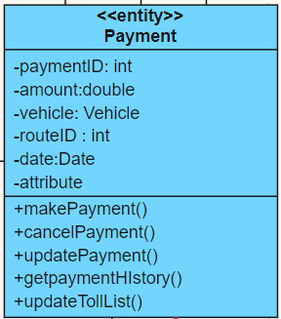
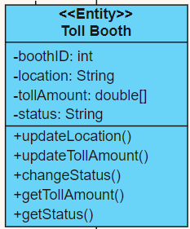
User: Route Management
Implementation View
*
1
1
*
1
1
1
1
*
Class Diagram: Detailed

Slide 16
User Module
1.4 User History

Slide 17
User: User History
Description
User History sub module has the following tasks:
View Recharge History
View dues history
View Transaction History
View statistics
Model | View | Controller
Recharge Due Payment | UserHistoryUI | UserController

Slide 18
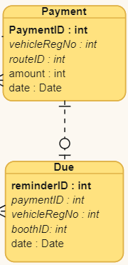
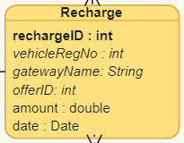
User: User History
High Level View
UserHistoryUI
UserController
1
1
1
*
*
Recharge
Payment
*
1
Due
0..1
Class Diagram: high level
ER Diagram

Slide 19
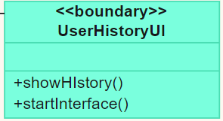
User: User History
Implementation View
*
1
*
1
1
1
*
0..1
Class Diagram: Detailed

Slide 20
2. Admin Module
2.1 Profile Management

Slide 21
Admin: profile management
Description
Admin profile management sub module has the following tasks:
Log in
Sign Up
Profile Info View
Profile Info Edit
Homepage navigation
Model | View | Controller
Admin | AdminLoginUi AdminHomeUi AdminInfoUI | Admin Controller

Slide 22
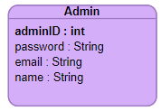
Admin: profile management
High Level View
Admin
LoginUi
Admin
HomeUi
Admin
InfoUI
AdminController
1
1
Admin
Class Diagram: high level
ER Diagram: high level

Slide 23
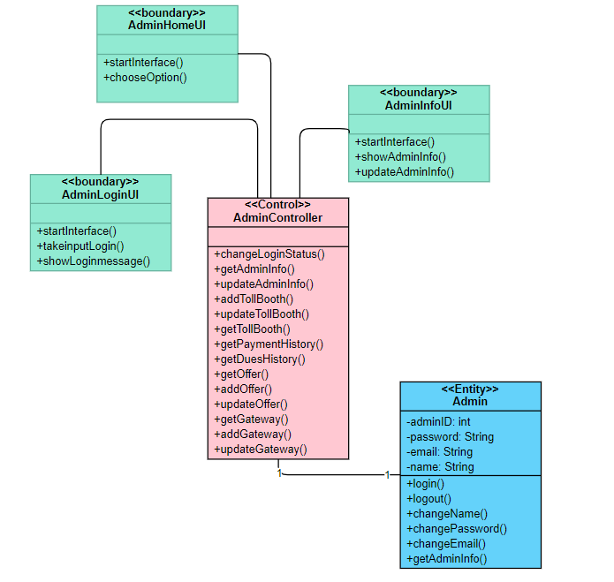
Admin: profile management
Implementation View
Class Diagram: Detailed

Slide 24
2. Admin Module
2.2 Offer Management

Slide 25
Admin: offer management
Description
Admin offer management sub module has the following tasks:
Add new Offer
Update existing Offer
Show Offer view
Model | View | Controller
Admin | AddOfferUi offersShowUi | Admin Controller

Slide 26
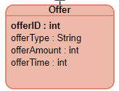
Admin: offer management
High Level View
ShowOffersUi
AddOfferUi
AdminController
1
*
Offer
Class Diagram: high level
ER Diagram: high level

Slide 27
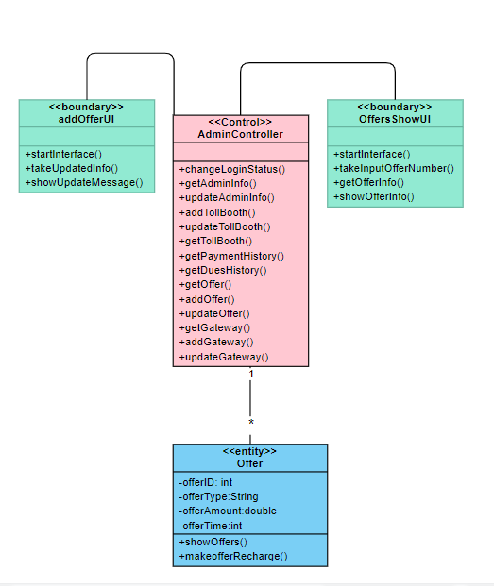
Admin: offer management
Implementation View
Class Diagram: Detailed

Slide 28
2. Admin Module
2.3 Toll Booth Management

Slide 29
Admin: toll booth management
Description
Admin toll booth management sub module has the following tasks:
Install new toll booth
Update existing toll booth
Show toll booth info view
Model | View | Controller
TollBooth | TollInfoShowUi InstallTollUi | Admin Controller

Slide 30
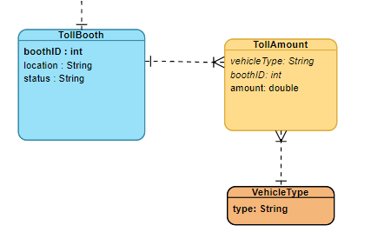
Admin: toll booth management
High Level View
TollInfoShowUi
InstallTollUi
AdminController
1
*
TollBooth
Class Diagram: high level
ER Diagram: high level

Slide 31
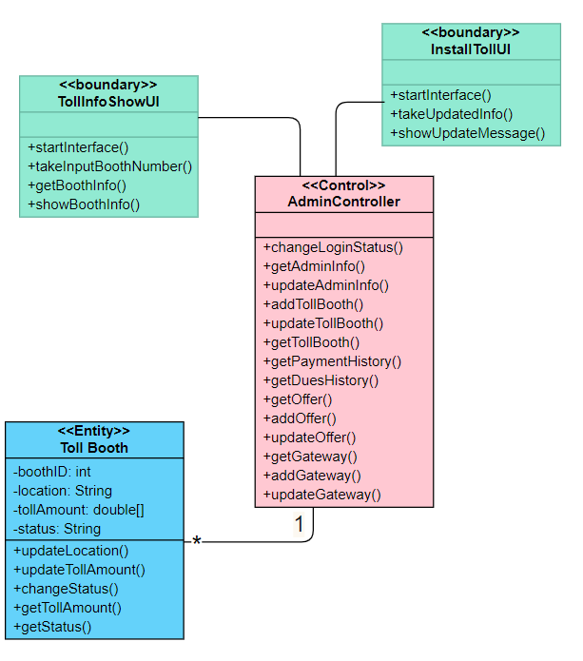
Admin: toll booth management
Implementation View
Class Diagram: Detailed

Slide 32
2. Admin Module
2.4 Gateway Management

Slide 33
Admin: gateway management
Description
Admin gateway management sub module has the following tasks:
Add a new gateway
Update gateway
Get gateway info view
Model | View | Controller
Gateway | addGatewayUi showGatewayUi | Admin Controller

Slide 34
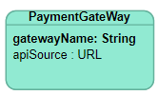
Admin: gateway management
High Level View
addGatewayUi
showGatewayUI
AdminController
1
1..*
Gateway
Class Diagram: high level
ER Diagram: high level

Slide 35
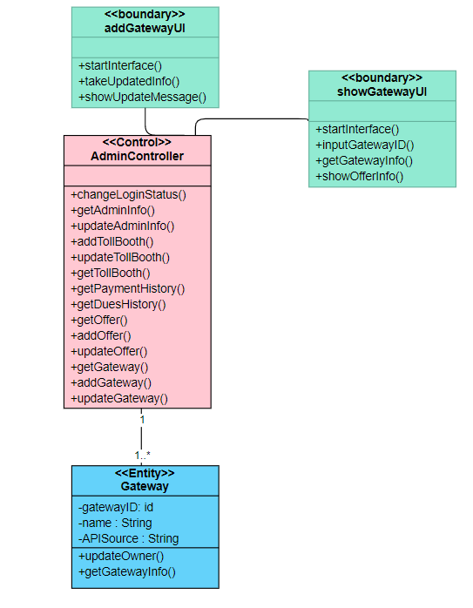
Admin: gateway management
Implementation View
Class Diagram: Detailed

Slide 36
2. Admin Module
2.5 Financial Management

Slide 37
Admin: financial management
Description
Admin financial management sub module has the following tasks:
See Payment history
See Dues history
See payment or due history for chosen vehicle number
Model | View | Controller
Payment Due Vehicle | showPaymentsUi showDuesUi | Admin Controller

Slide 38
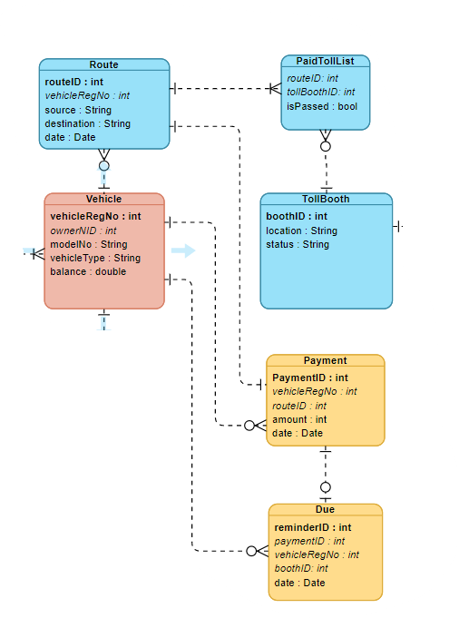
Admin: financial management
High Level View
TollBoothUi
TollBoothController
1
1
1
*
*
*
1
Due
Payment
Vehicle
0..1
*
*
1
1
Class Diagram: high level
ER Diagram: high level

Slide 39
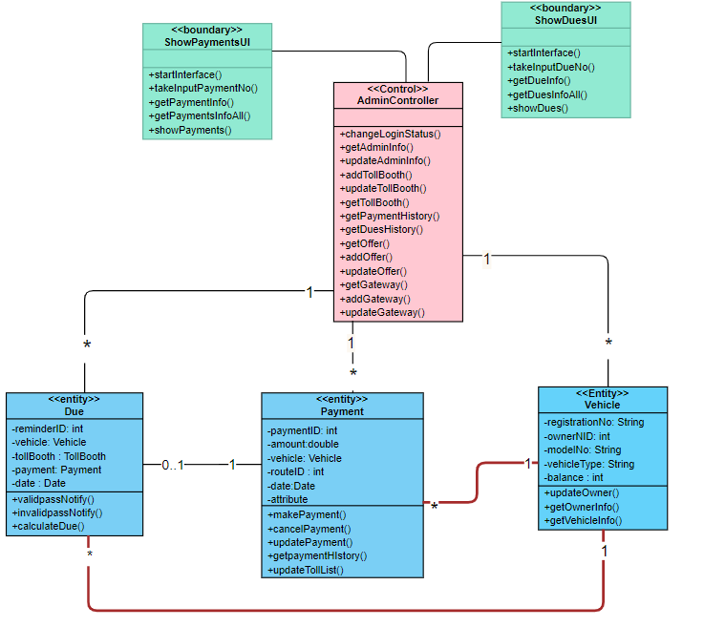
Admin: financial management
Implementation View
Class Diagram: Detailed

Slide 40
3. Toll scanning Module
3.1 Cash Management

Slide 41
Toll Booth: cash management
Description
Admin cash management sub module has the following tasks:
Check payment for a scanned vehicle
Create due for a unpaid passed vehicle
Model | View | Controller
Due Payment TollBooth | TollBoothUi | TollBooth Controller

Slide 42
Toll Booth: cash management
High Level View
TollBoothUi
TollBoothController
1
1
1
*
*
*
1
Due
Payment
Toll Booth
0..1
Class Diagram: high level
ER Diagram: high level

Slide 43
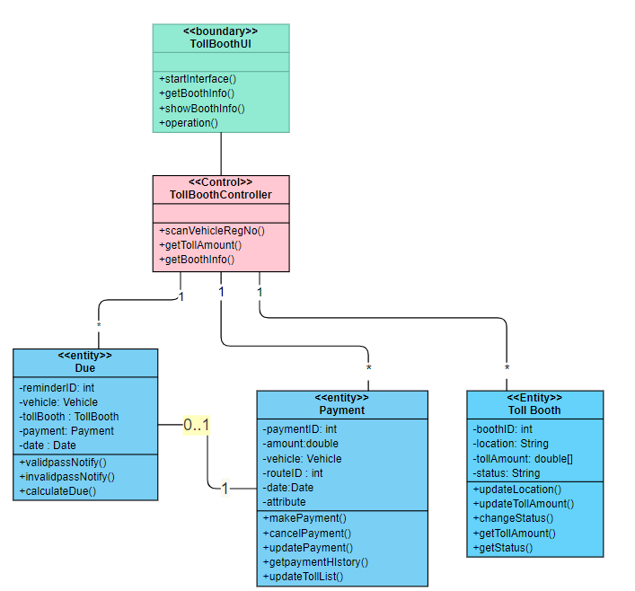
Toll Booth: cash management
Implementation View
Class Diagram: Detailed

Slide 44
Final UML Diagrams
Class Diagram & Entity Relationship Diagram

Slide 45
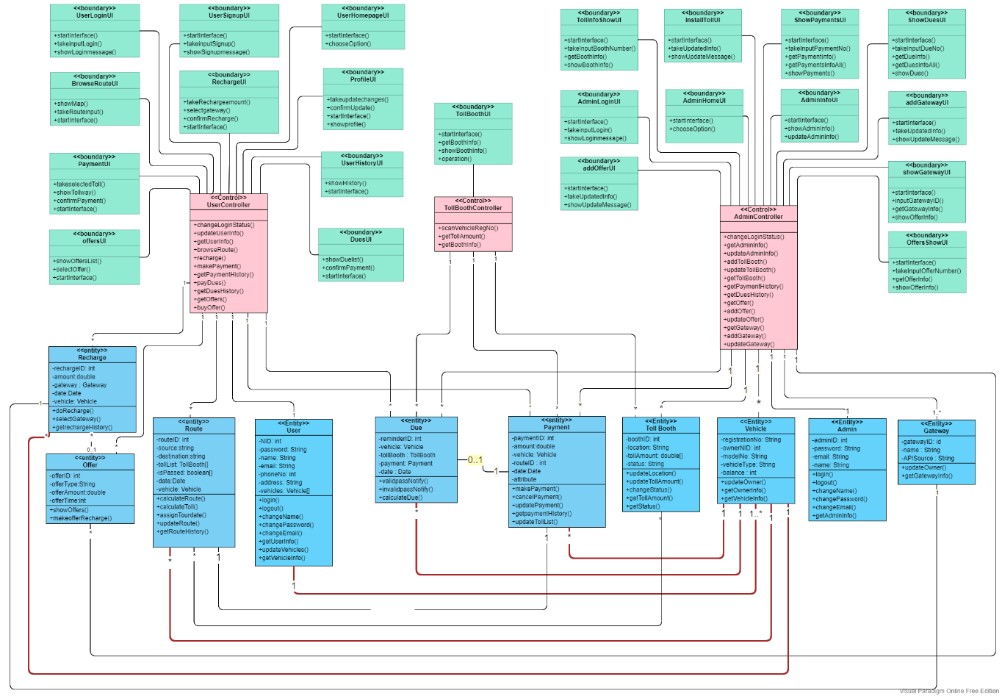
Full Class Diagram

Slide 46
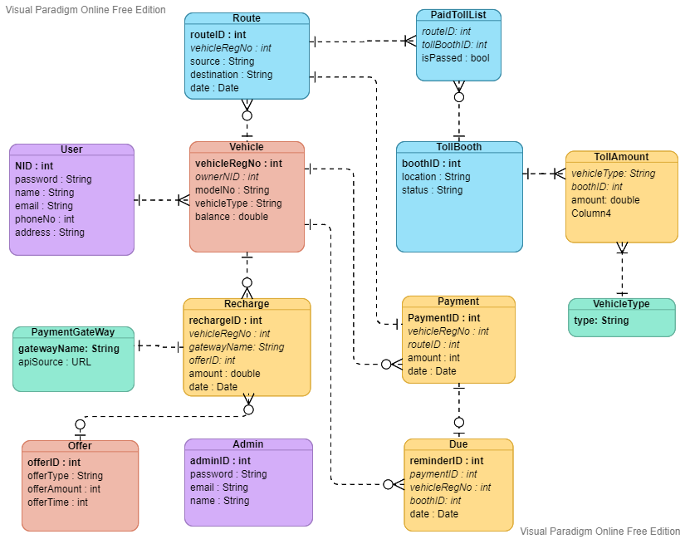
Full Entity Relationship Diagram

Slide 47
Thank You

